Slide 1
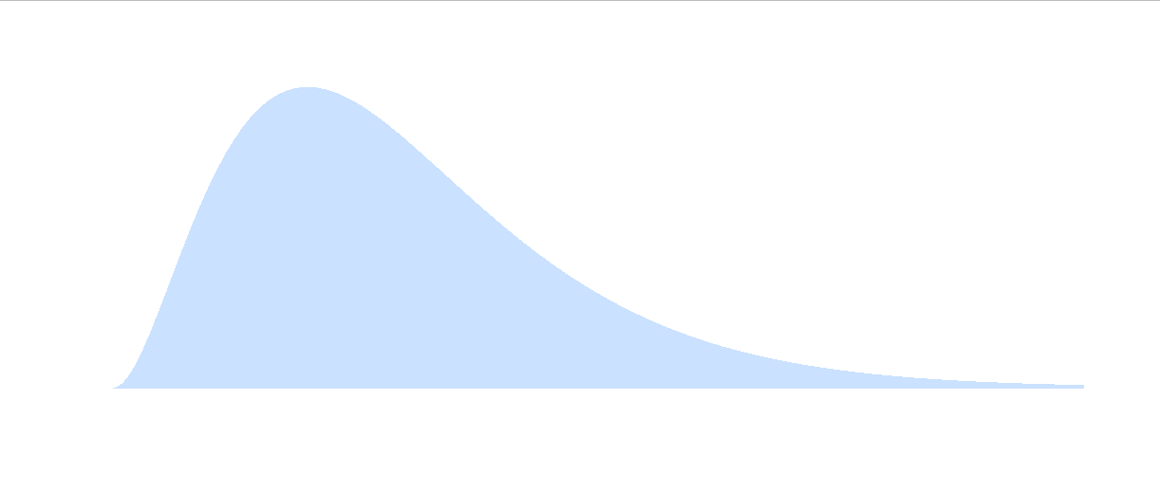
Stat xchange

Slide 2
Stat xchange

Slide 3

S

Slide 5
Code for plot
curve(dgamma(x,3,2),0,5, col = "white")
segments(x0=seq(0,5,by=.001),x1=seq(0,5,by=.001),y0=0,y1=dgamma(seq(0,5,by=.001),3,2), col = 'lightblue’)

